Slide 1
Config Boot in ldrom
APROM 63KB-1KB
Checksum Pass
LDROM 4KB
ISP ldrom jump
FW length and checksum in last word
APROM 512B
User data
APROM 512B
User image

Slide 2
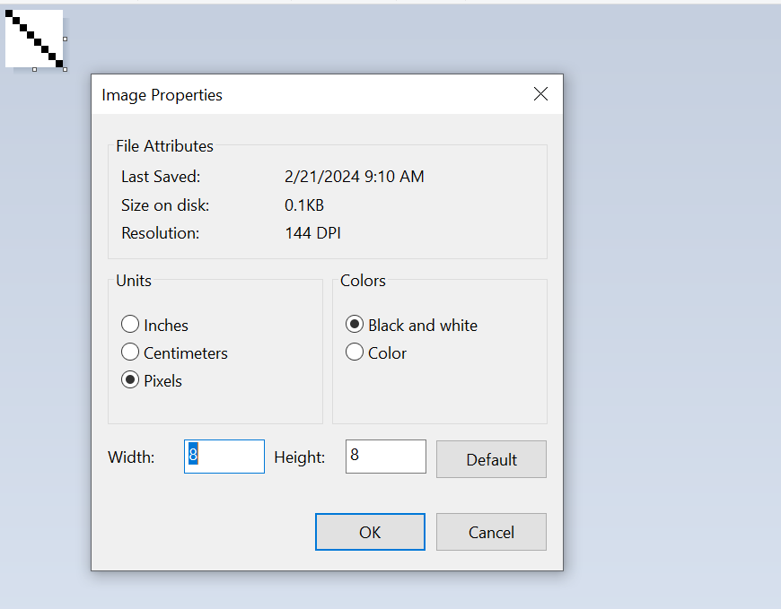
Image format
Paint.exe
放大800倍去edit image

